Slide 1
TESLA COIL
<--THE WIRELESS ERA-->

Slide 2
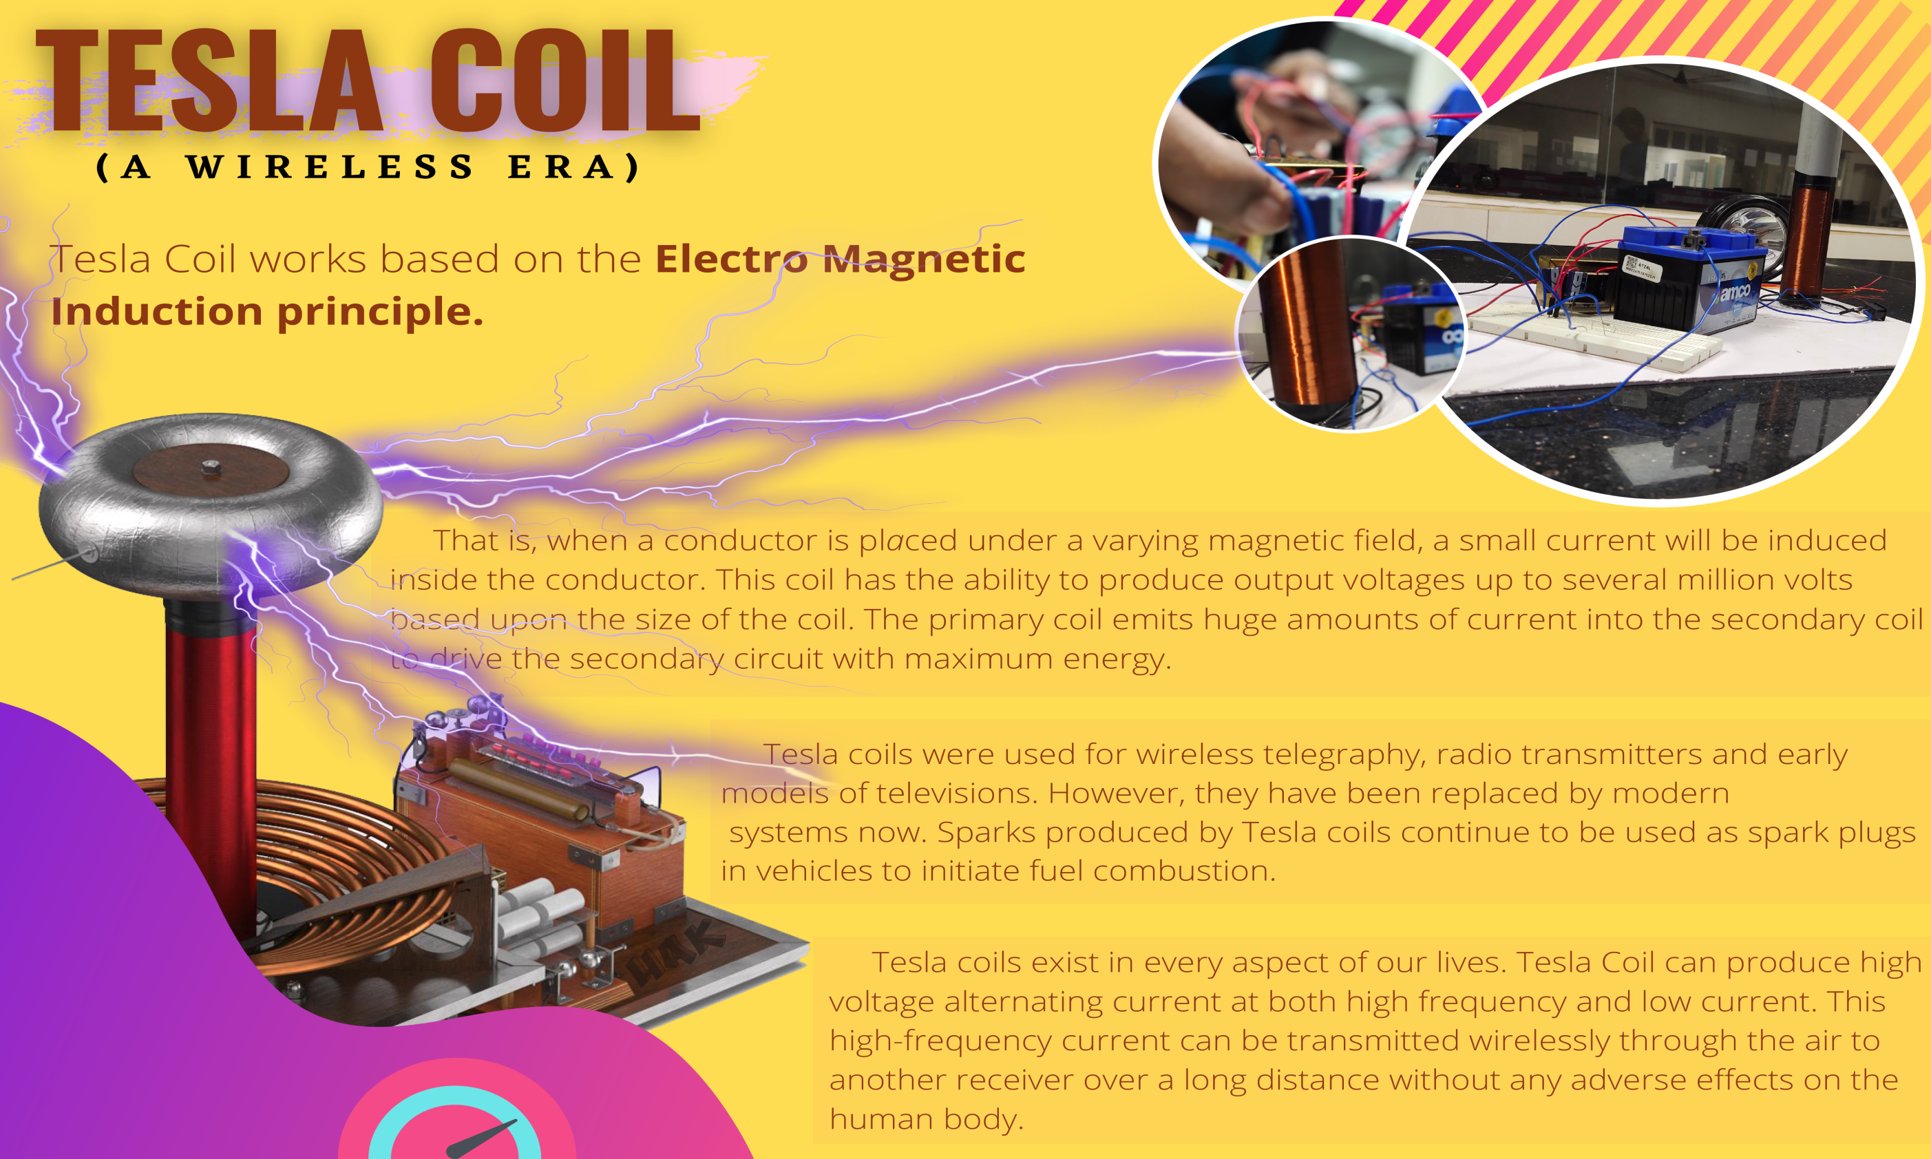

Slide 3
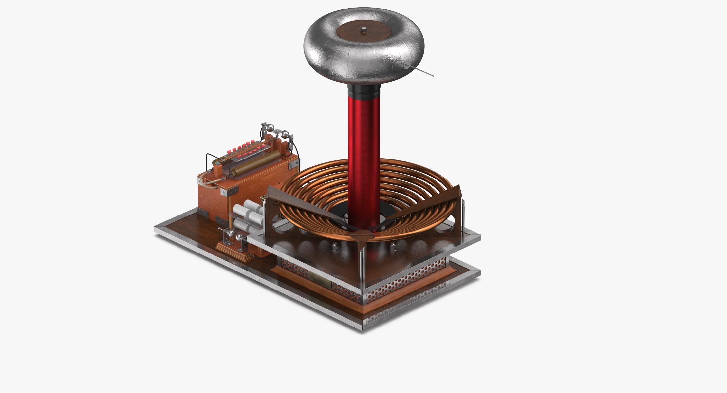
MODEL

Slide 4
A Tesla coil is an electrical resonant transformer circuit designed by inventor Nikola Tesla in 1891. It is used to produce high-voltage, low-current, high frequency alternating-current electricity. Tesla experimented with a number of different configurations consisting of two, or sometimes three, coupled resonant electric circuits.
Tesla used these circuits to conduct innovative experiments in electrical lighting, phosphorescence, X-ray generation, high frequency alternating current phenomena, electrotherapy, and the transmission of electrical energy without wires. Tesla coil circuits were used commercially in spark gap radio transmitters for wireless telegraphy until the 1920s, and in medical equipment such as electrotherapy and violet ray devices. Today, their main usage is for entertainment and educational displays, although small coils are still used as leak detectors for high vacuum systems
Originally, Tesla coils used fixed spark gaps or rotary spark gaps to provide intermittent excitation of the resonant circuit; more recently electronic devices are used to provide the switching action required. With solid-state drivers, a Tesla coil can be used to generate audible tones, to produce musical effects. While the AC produced by the Tesla coil is of high frequency, the skin effect will not protect a human from deep tissue burns if in contact with the high voltage circuit.

Slide 5
WORKING PRINCIPLE :
This works with the principle of Electromagnetic Induction.
That is, when a conductor is placed under a varying magnetic field, a small current will be induced inside the conductor.
This coil has the ability to produce output voltages up to several million volts based upon the size of the coil.
The Tesla coil works on a principle to achieve a condition called resonance.
Here, the primary coil emits huge amounts of current into the secondary coil to drive the secondary circuit with maximum energy.
The fine-tuned circuit helps to shoot the current from primary to secondary circuit at a tuned resonant frequency.

Slide 6
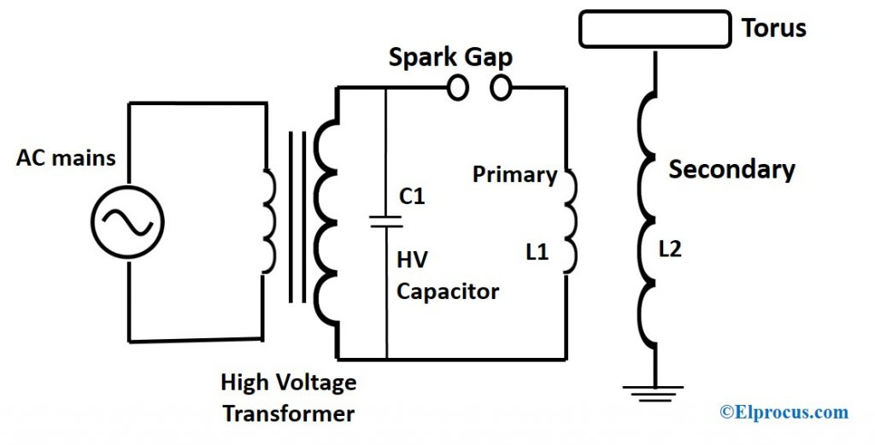
GENERAL CIRCUIT

Slide 7
Oscillation Frequency
The combination of a capacitor and primary winding ‘L1’ of the circuit forms a tuned circuit. This tuned circuit ensures that both primary and secondary circuits are finely tuned to resonate at the same frequency. The resonant frequencies of the primary ‘f1’ and secondary circuits ‘f2’ and are given by,
f1=1/2π√L1C1 and f2=1/2π√L2C2
As the secondary circuit cannot be adjusted, the moveable tap on ‘L1’ is used to tune the primary circuit till both the circuits resonate at the same frequency. Therefore, the frequency of the primary is the same as the secondary.
f = 1/2π√L1C1 =1/2π√L2C2
The Condition for primary and secondary to resonate at the same frequency is,
L1C1= L2C2
The output voltage in the resonant transformer does not depend on the number-of-turns ratio as in ordinary transformer. As soon as the cycle begins and as the spar sets up, the primary circuit’s energy is stored in the primary capacitor ‘C1’ and the voltage at which the spark breaks down is ‘V1’.
W1=1/2C1V1²

Slide 8
Tesla used these circuits to conduct innovative experiments in electrical lighting, phosphorescence, X-ray generation high frequency alternating current phenomena, electrotherapy, and transmission of electrical energy without wires.
ADVANTAGE OF TESLA COIL :-
* High performance.
* Voltages build up at a slower pace so there is less chance of damage.
* Distributes the same voltage across all winding coils.
* Powers The use of 3-phase rectifiers for higher powers can provide tremendous load sharing.
* Non- radiative energy transfer is safe for people and animals.
* Wastage of power is less.
* Does not interfere with radio waves.
THE DISADVANTAGE OF TESLA COIL:-
*Tesla coil poses several health hazards due to high voltage radio frequency emission that includes skin burn, damage to the nervous system and heart.
* Involves high costs in buying large DC smoothing capacitor.
*Construction of circuit consumes much time as it needs to be perfect to resonate

Slide 9
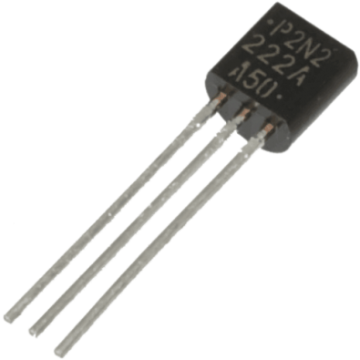
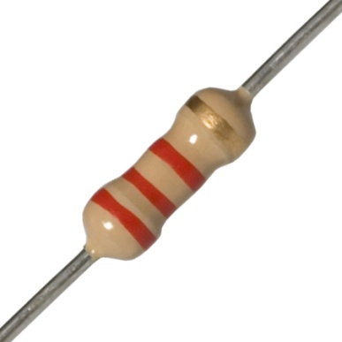
The 2N2222A is a common NPN bipolar junction transistor (BJT) used for general purpose low-power amplifying or switching applications. It is designed for low to medium current, low power, medium voltage, and can operate at moderately high speeds. It was originally made in the TO-18 metal can as shown in the picture.
SPECIFICATION:
The JEDEC registration of a device number ensures particular rated values will be met by all parts offered under that number. JEDEC registered parameters include outline dimensions, small-signal current gain, transition frequency, maximum values for voltage withstand, current rating, power dissipation and temperature rating, and others, measured under standard test conditions. Other part numbers will have different parameters. The exact specifications depend on the manufacturer, case type, and variation. Therefore, it is important to refer to the datasheet for the exact part number and manufacturer.
22K Ohm 1W High Quality Carbon Film Resistor (CFR) with ±5% Tolerance and Tin Plated Copper Leads. ... Resistance: 22K Ohm, Power Rating: 1 Watt, Approximate Maximum Current: 6.74mA

Slide 10
CONCLUSION:
Tesla coil exist in every aspect of our lives. Tesla coil can produce high voltage alternating current at both high frequency current can be transmitted wirelessly through the air to another receiver over a long distance without any adverse effects on the human body.

